Slide 1

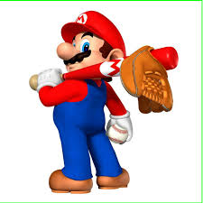
Baseball VII
Produced by Dr. Mario | UNC STOR 538

Slide 2
Streakiness in Sports
Question? When Can We Say a Batter is HOT or COLD?
Hypothetical Batter With Batting Average of 0.333
Each Plate Appearance, Batter has a 33.3% Chance of Hitting
HOT = Player Has an Unusual # of Consecutive Hits
COLD = Player Has an Unusual # of Consecutive Misses
Ignore Walks and Hit-by-Pitches
Simulation
1,000,000 Plate Appearances
33.3% Chance of Hitting & 66.7% Chance of Not Hitting
Consider Possible Hitting Streaks and Hitting Slumps of 1 to 15
In 1 Million Plate Appearances, What Would be Considered a HOT Hitting Streak and COLD Hitting Slump?

Slide 3
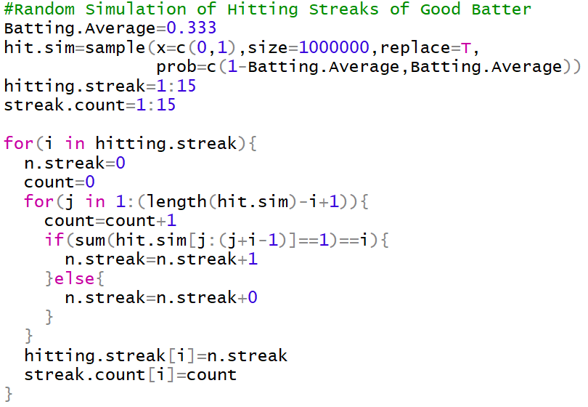
Streakiness in Sports

Slide 4
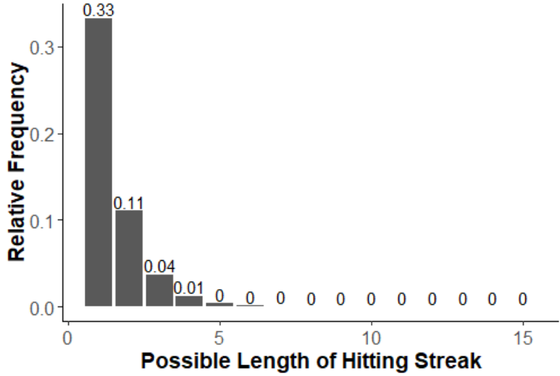
Streakiness in Sports

Slide 5
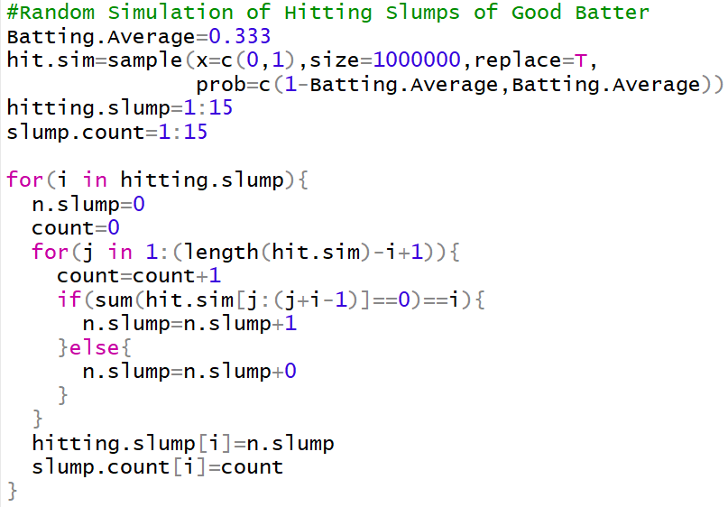
Streakiness in Sports

Slide 6
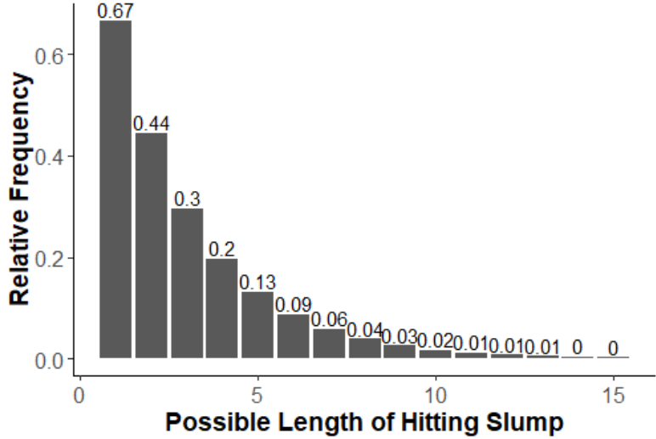
Streakiness in Sports

Slide 7
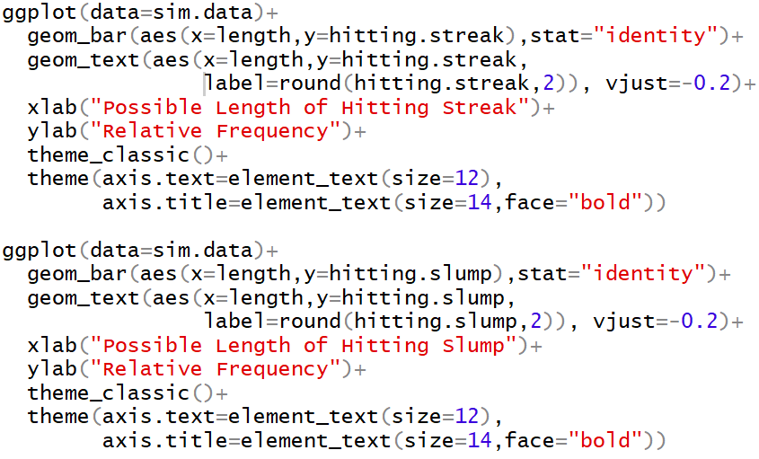
Streakiness in Sports
R Code for Figures

Slide 8





Streakiness in Sports
Wald Wolfowitz Runs Test (WWRT)
Topic Streakiness Pertaining to Wins (W) and Losses (L)
Suppose a Teams Record is 5-5 (W-L)
Streaky Would Be WWWWWLLLLL (2 Runs)
Not Streaky Would Be WLWLWLWLWL (10 Runs)
Idea: Fewer Runs = More Streaky
Let W=# of Wins, L=# of Losses, and T=W+L
According to Wold and Wolfowitz, if X=Number of Runs,
For Team with 5-5 Record, $μ=6$ and $σ=1.49$
$$VAR\left[X\right]=σ^{2}=\sqrt{\frac{(μ−1)(μ−2)}{T−1}}$$
$$E\left[X\right]=μ=\frac{2×W×L}{T}+1$$
$$Z_{1}=\frac{2−6}{1.49}=−2.68$$
$$Z_{2}=\frac{10−6}{1.49}=2.68$$

Slide 9
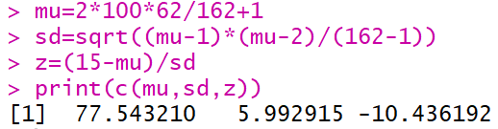

Streakiness in Sports
Hypothesis Test
Null: W’s and L’s are Randomly Distributed
Alternative: W’s and L’s are Streaky
Random Variable Z Has Approximate Normal Distribution if Number of Games T is Long Enough
If $Z<−2$, We Would Determine That Team is Streaky
Suppose in 162 Games, Team is 100-62 with 15 Runs
Test Statistic
Conclusion: Ultra Streaky Bruh

Slide 10
Evaluating the Greatest Streak
Joe DiMaggio
Played 13 Seasons With the New York Yankees
Known for 56 Game Hitting Streak (1941)
“Most Enduring Record in Sports” -New York Times
Johnny Vander Meer
Known for Time With the Cincinnati Reds
No-Hitter Against the Boston Bees (June 11,1938)
No-Hitter Against the Brooklyn Dodgers (June 15, 1938)
No Other Pitcher Has Matched This
What is the Most Difficult Achievement?

Slide 11






Evaluating the Greatest Streak
Modeling Probabilities Using Poisson Distribution
Useful for Random Variable $X∈\{0,1,2,3,…\}$
Probability Mass Function
Expected Value
Usage in R: Super Mario Averages 5 Shrooms Per Day
$$P\left(X=x\right)=\frac{λ^{x}e^{−λ}}{x!}$$
$$E[X]=λ$$
$$E\left[X\right]=λ=5$$
$$P\left(X=7\right)=10.4\%$$

Slide 12



Evaluating the Greatest Streak
Probability of Independent Events
If Events A and B are Independent,
Usage in R: Probability Super Mario Fasts for 5 Straight Days
Random Variables $X_{1},X_{2},X_{3},X_{4},X_{5}$
Assume They Are Independent and Identically Distributed
$$P\left(A∩B\right)=P\left(A\right)×P(B)$$
$$P\left(FAST\right)=P\left(X_{1}=0\right)×P(X_{2}=0)⋯×P(X_{5}=0)$$
$$=P{\left(X_{1}=0\right)}^{5}$$

Slide 13
Evaluating the Greatest Streak
How Rare Was Joe DiMaggio’s Achievement?
Assumptions
Batters Need At Least 500 At-bats
Not Include Hitting Streaks Across Seasons
Batters with Over 500 At-bats Averaged 3.5 At-bats Per Game (Equivalent to 3 At-bats for Half Season and 4 At-bats for Remaining
Suppose Batter Hits .333 in 1900 (154 Game Season)
Probability of Event A3 = Batter Gets a Hit in 3 At-bat Game
Probability of Event A4 = Batter Gets a Hit in 4 At-bat Game
Probability of Event A = Hit During 56 Consecutive Games
$$P\left(A3\right)=1−{\left(1−.333\right)}^{3}=70.33\%$$
$$P\left(A4\right)=1−{\left(1−.333\right)}^{4}=80.21\%$$
$$P\left(A\right)=P{\left(A3\right)}^{28}×P{\left(A4\right)}^{28}=0.000011\%$$

Slide 14

Evaluating the Greatest Streak
How Rare Was Joe DiMaggio’s Achievement?
Number of Opportunities to Start Hitting Streak Where Batter is Hitless During the Previous Game
Approximate Probability of Event E = Hitless Game
Average Number of Opportunities to Start Winning Streak
Expected Number of 56 Game Hitting Streaks in a Season
$$154−56=99 Opportunities$$
$$P\left(E\right)=\frac{(1−P\left(A3\right))+(1−P\left(A4\right))}{2}=24.7\%$$
$$1+98×0.247=25.21 Opportunites$$
$$25.21×P\left(A\right)=0.0000027$$

Slide 15
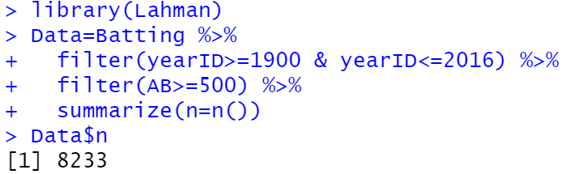

Evaluating the Greatest Streak
How Rare Was Joe DiMaggio’s Achievement?
Total Number of Batters Between 1900 and 2016 = 8233
Expected Number of 56 Game Winning Streaks for All Batters
Probability of Event H = At Least 1 Hitting Streak of 56 Games
Batter With Batting Average of 0.33 Requires 9,926 Seasons to Have a 50% Chance of Getting the 56 Game Winning Streak
$$λ=E\left[Player_{1}\right]+E\left[Player_{2}\right]+⋯+E\left[Player_{8233}\right]≈.024$$
$$P\left(H\right)=1−P\left(\overline{H}\right)=1−\frac{λ^{0}e^{−λ}}{0!}≈2.4\%$$

Slide 16
Evaluating the Greatest Streak
How Rare Was Johnny Vander Meer’s Achievement?
Assumptions
All Games Are Started by Pitchers Who Start Exactly 35 Games (Exactly 951 Pitchers Under This Criteria from 1900 to 2016)
Assume Probability of No Hitter is 0.062% for All Pitchers for Every Single Game
Following Similar Ideas from DiMaggio, the Probability of Event N = At Least 1 Starting Pitcher Would Throw Consecutive No Hitters
Both Achievements Are Unlikely But Possible
Both Achievements Become More Likely As Time Passes
$$P\left(N\right)=15.7\%$$

Slide 17
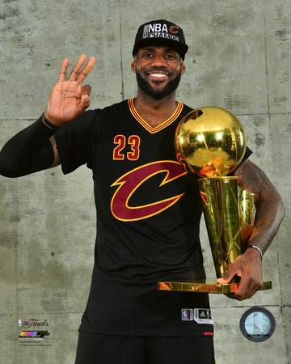
Evaluating the Greatest Streak
What is the Most Difficult Achievement?
Trick Question…
Lebron James Winning a Championship for Cleveland #216

Slide 18
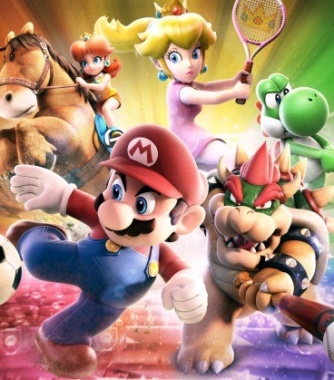
Final Inspiration
So I’m ugly. So what?
I never saw anyone hit with his face.
-Yogi Berra

